Slide 1

MarketPulse: Stock Price Prediction with Social Media and Financial News
Course: CS-5588
Team GameStop
2024-09-03

Slide 2





🤝 Team Members
Odai Athamneh - ML Engineering
Devin Cline - Product Architecture
Semir Hot - Team Leader
Namuun Lkhagvadorj - Financial Analysis

Slide 3

🚨 Problem Statement
Financial markets are complex and rapidly changing
Conventional tools can't fully predict market behaviors
Static nature
Inability to handle large, unstructured datasets
Use ML to extract actionable insights from:
Real-time data
Social media
Financial news

Slide 4

🎯 Objectives & Approach
Objective: Utilize advanced machine learning techniques to predict stock market movements.
Data Utilization:
Historical Stock Data: Leverage patterns from past market behavior.
Social Media: Analyze sentiment from platforms to gauge public perception.
Financial News: Incorporate real-time financial news for dynamic insights.
Methodology Overview:
Integration: Combine diverse data sources for a multidimensional analysis.
Sentiment Analysis: Develop models to assess the impact of news and social media on market trends.
Feature Engineering: Extract and refine features that significantly influence stock movements.
Machine Learning Models:
LSTM Networks
Continuous Learning

Slide 5
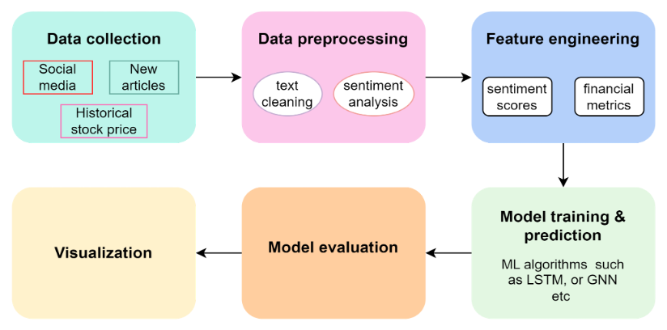
🔧 Project Pipeline

Slide 6

💥 Expected Impact & Evaluation
Impact: Enhances investment strategies and informs economic policies.
Evaluation Metrics:
RMSE: Quantifies prediction errors.
MAE: Averages absolute prediction errors.
Goals:
Ensure model's adaptability and superior accuracy.
Set new benchmarks in financial modeling.

Slide 7

🔮 Challenges & Future Work
Data Collection Challenges:
Continuous generation of social media and news data
Difficulties in capturing comprehensive datasets from diverse sources
Potential Improvements:
Improved sentiment analysis with cutting-edge NLP approaches
Bigger datasets
Employ time-series analysis and include external economic indicators
Future Directions:
Explore real-time data updating systems to enhance prediction responsiveness
Consider integrating machine learning models with user feedback to continuously improve prediction accuracy

Slide 8

♻️ Existing projects
Stock market analysis with news sentiment analysis
https://github.com/gandalf1819/Stock-Market-Sentiment-Analysis
Stock market analysis with twitter sentiment analysis
https://github.com/sardarosama/Stock-Market-Trend-Prediction-Using-Sentiment-Analysis
Chat GPT-informed GNN
https://github.com/ZihanChen1995/ChatGPT-GNN-StockPredict
Stock Price Prediction Using Financial News Articles https://ieeexplore.ieee.org/stamp/stamp.jsp?tp=&arnumber=5609404
Forecasting stock prices using LLMs with financial news
https://community.wolfram.com/groups/-/m/t/2959055 [WSS23] Forecasting stock prices using LLMs with financial news - Online Technical Discussion Groups—Wolfram Community

Slide 9

🔚 Conclusion
Recap of Key Points:
Addressing the complexities of today's financial markets with advanced analytics.
Integrating diverse data from stock prices, social media, and financial news.
Employing machine learning models, including sentiment analysis and LSTM networks.
Expected Outcomes:
Improved accuracy in predicting stock market trends.
Better investment decision-making support.
Real-time market insights with continuous data integration.

